Slide 1
Solar Panel Gazebo
Ahmad El-Hajj

Slide 2
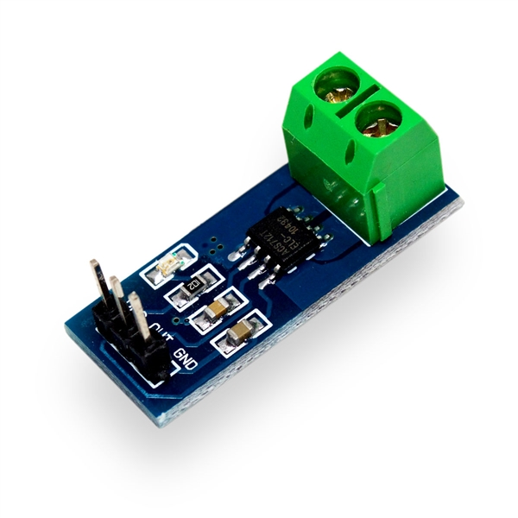
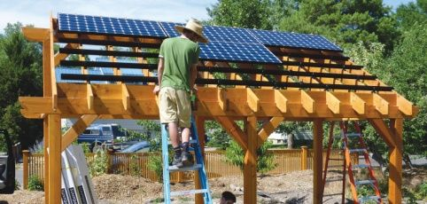
Introduction
Monitor Solar panel every 30 minutes
Data will be gathered from 4 solar panels
Measuring current of the solar panel
ACS712

Slide 3
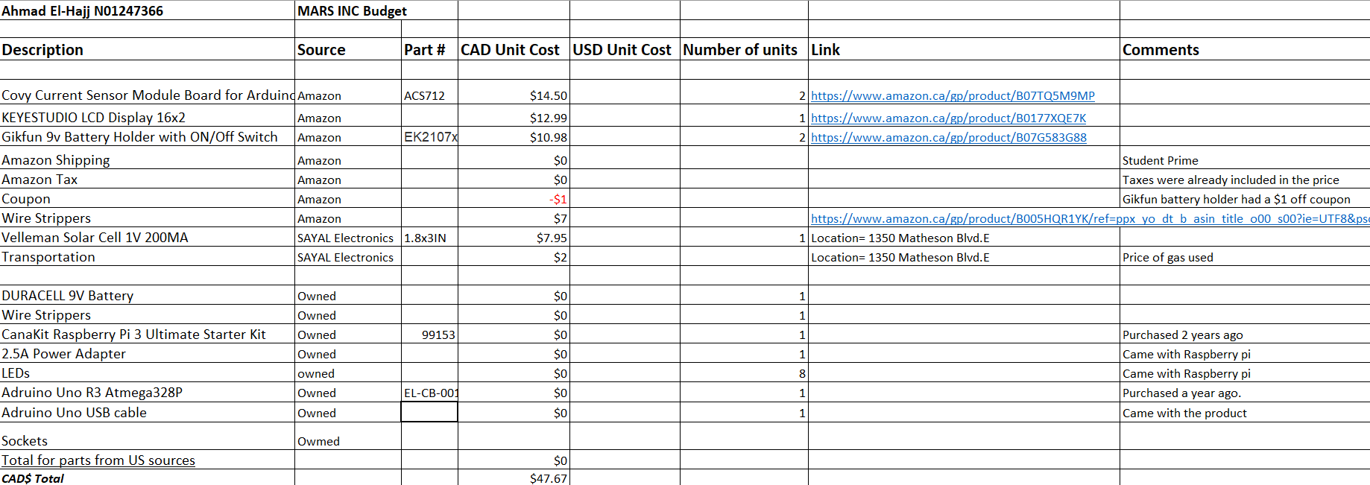
Budget

Slide 4
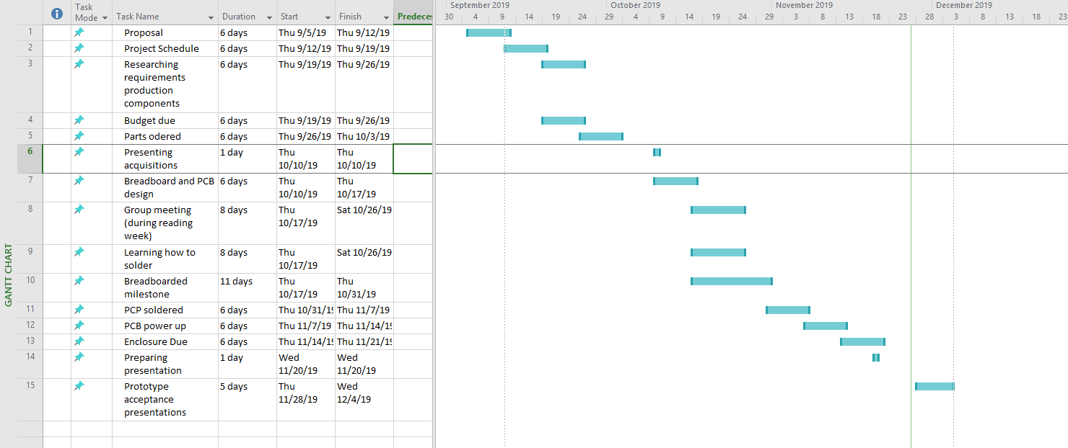
Schedule

Slide 5
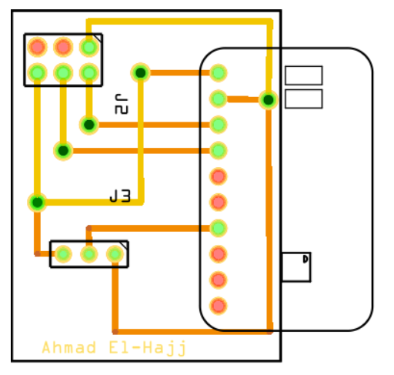
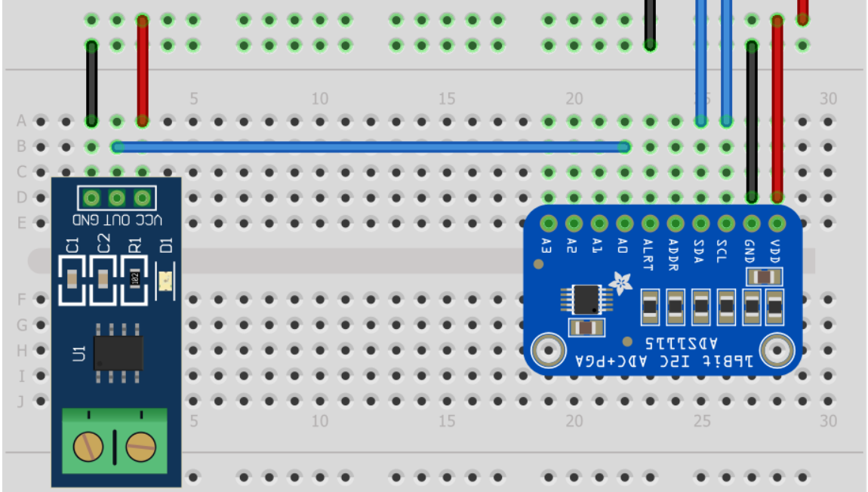
BreadBoard

Slide 6
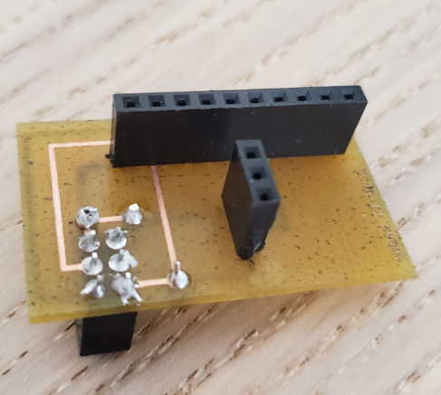
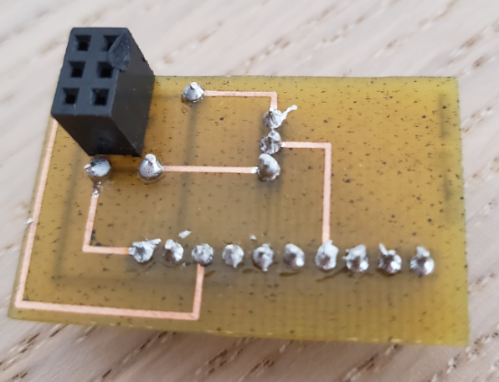
PCB Soldered

Slide 7
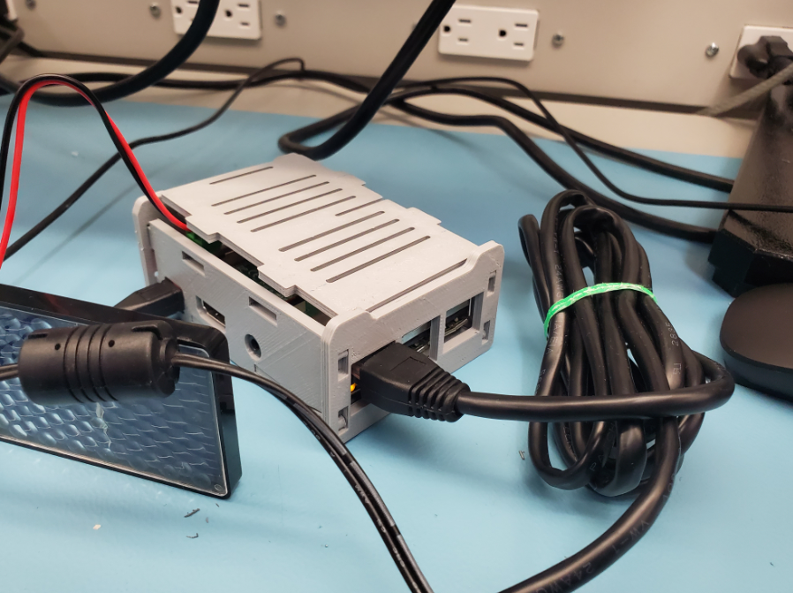
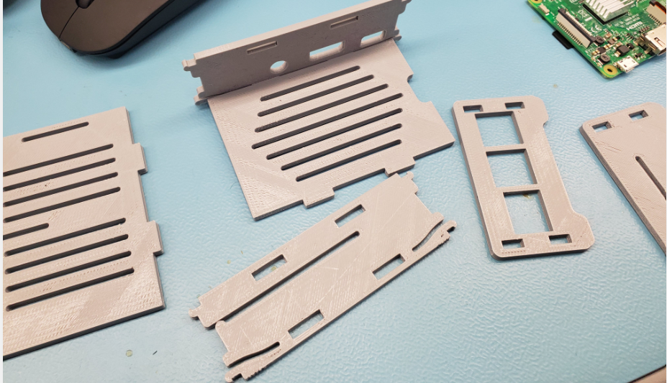
Raspberry Pi Case

Slide 8
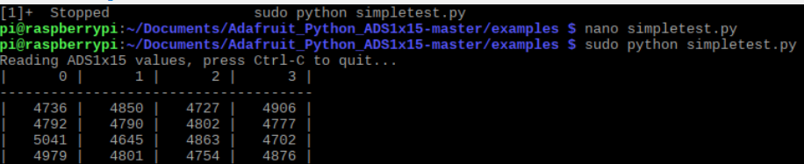
Test code

Slide 9
Course Knowledge
Technical C
Unix Internals
https://learn.adafruit.com/raspberry-pi-analog-to-digital-converters/ads1015-slash-ads1115
Embedded Systems

